Slide 1


Map, Layers, Renderers
Esri Developer Summit
March 8–11, 2016 | Palm Springs, CA
Chris Fox

Slide 2

Map and Layer
Map
Recap: Accessed from the Project as MapProjectItem
Also accessed off the active MapView
2D and 3D:
QueuedTask.Run(() => {
var mpi = Project.Current.GetItems<MapProjectItem>()
.First(m => m.Name == "Map1");
var map = mpi.GetMap();
});
var map = MapView.Active.Map;
public enum MapViewingMode {
Map,
SceneLocal,
SceneGlobal}
Notes:
Map: Data is displayed on a 2D surface, only valid for 2D Maps.
SceneLocal: Data is projected on to a surface, only valid for 3D Scenes.
SceneGlobal: Data is projected on to a spherical globe, only valid for 3D Scenes.

Slide 3
Map
2D and 3D.
Create with MapFactory.
Use Defaults.
Use Items
QueuedTask.Run(() => {
MapFactory.CreateMap("Map", MapType.Map,
MapViewingMode.Map, Basemap.Streets); }
var item = ItemFactory.Create(@"C:\Data\SDK\ForDemo.mxd", ItemFactory.ItemType.PathItem);
await Project.Current.AddAsync(item);
//Or, use map factory
await MapFactory.CreateMapAsync(item);
Notes:
“Map” analogous to data frame.

Slide 4
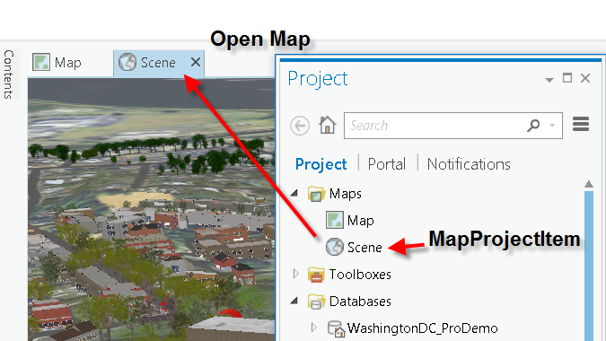
Map
To Open A Map
await ProApp.Panes.CreateMapPaneAsync(map);
Notes:
Note: To get the map panes:
IEnumerable<IMapPane> mapPanes = ProApp.Panes.OfType<IMapPane>().OrderBy((mp) => mp.MapView.Map.URI ?? mp.MapView.Map.Name);
Note: One map can be associated with many MapViews:
//group by map URI or name
var mapPanes = ProApp.Panes.OfType<IMapPane>()
.GroupBy((mp) => mp.MapView.Map.URI).Select(grp => grp.FirstOrDefault());
List<Map> uniqueMaps = new List<Map>();
foreach (var pane in mapPanes)
uniqueMaps.Add(pane.MapView.Map);//these are the unique set of maps across all panes

Slide 5
MapMember
MapMember
Layer
BasicFeatureLayer
BasicRasterLayer
StandaloneTable
FeatureLayer
AnnotationLayer
RasterLayer
ImageServiceLayer

Slide 6
Layers and Tables
Map is a container for the collection of Layers and Table
var layers = map.Layers;
var tables = map.StandaloneTables;
\\Convenience method to return all layers without group layers
layers = map.GetLayersAsFlattenedList()

Slide 7
Layer
Create layers using LayerFactory
Provide a path (Uri) or Item
/* string path = @"c:\data\project.gdb\DEM"; //Raster dataset from a File Geodatabase
* string path = @"c:\connections\mySDEConnection.sde\States\roads"; //SDE Feature class
* string path = @"c:\data\roads.shp"; //Shapefile
* string path = @"c:\data\imagery.tif"; //Image from a folder
* string path = @"http://myServer/ArcGIS/rest/services/Demographics/USA/MapServer;
* string path = @"http://myServer/arcgis/rest/services/Naperville/FeatureServer/0;
*/
string path = @"c:\data\project.gdb\roads"; //File Geodatabase feature class
Uri uri = new Uri(path);
Layer layer = await QueuedTask.Run(() =>
LayerFactory.CreateLayer(uri, MapView.Active.Map));

Slide 8
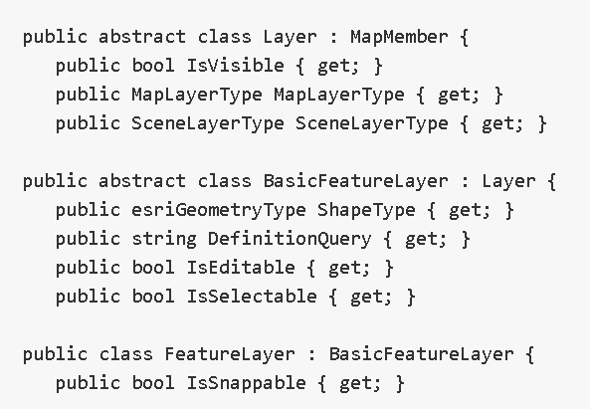
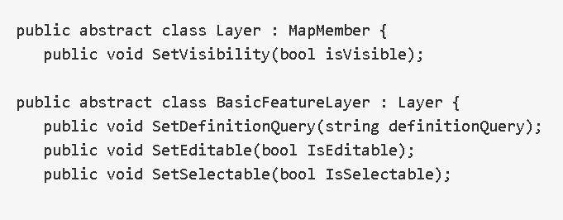
Layer Properties
The most common are provided as “get” wrappers. “Set” methods are provided to change common properties (that are writeable).
Notes:
The set methods commit the changes to the project repository
Set needs to happen on the main CIM thread.

Slide 9
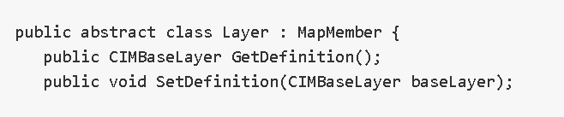
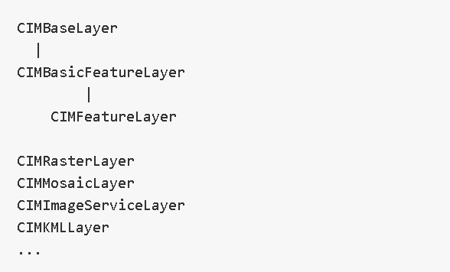
Layer Properties
All Layer Properties are accessible from the Layer Definition
Those without wrappers should be changed via the CIM definition. Cast the CIMDefinition to access properties specific to the layer type.
Notes:
Layers can be defined through the CIM but the idea is that over time DotNet wrapper classes are provided for all layer types. The direct use of CIM is not a recommended pattern.

Slide 10
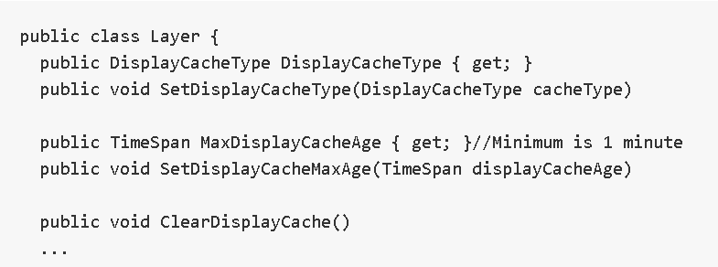
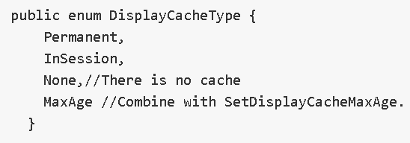
Layer Cache
Pro caches layers to optimize draw performance.
There may be a need to refresh a layer cache or NOT cache at all.
For example a service layer that is continuously updated
Unless your workflow requires it, it is best to let Pro manage layer caches
Notes:
Basemap: Permenant
Cache is stored at: C:\Users\[USER]\AppData\Local\ESRI\Local Caches

Slide 11
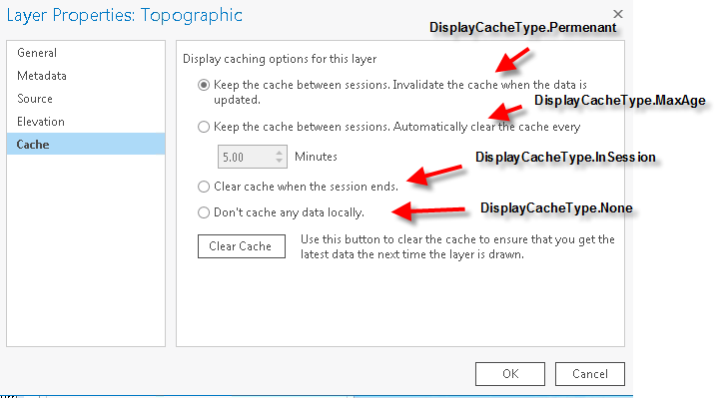
Layer Cache
Notes:
DisplayCacheType.Permenant is default for all layers

Slide 12
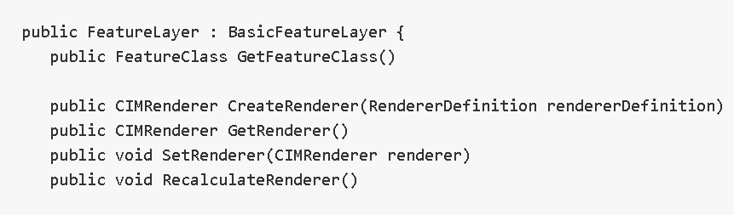
FeatureLayer Renderer
Feature layers have a renderer. The renderer controls the layer symbology and how it is applied when the layer is displayed.

Slide 13
FeatureLayer Renderer
Create a simple renderer (same symbol for all features):
await QueuedTask.Run(() => {
CIMStroke outline = SymbolFactory.ConstructStroke(
ColorFactory.Blue, 2.0, SimpleLineStyle.Solid);
CIMPolygonSymbol fillWithOutline = SymbolFactory.ConstructPolygonSymbol(
ColorFactory.Red, SimpleFillStyle.Solid, outline);
CIMSimpleRenderer simpleRenderer = layer.GetRenderer() as CIMSimpleRenderer;
//Update the symbol of the current simple renderer
simpleRenderer.Symbol = fillWithOutline.MakeSymbolReference();
//Update the feature layer renderer
layer.SetRenderer(simpleRenderer);
});
Notes:
Do the FeatureLayer demo here
Get renderer, change its symbol, set it back.

Slide 14
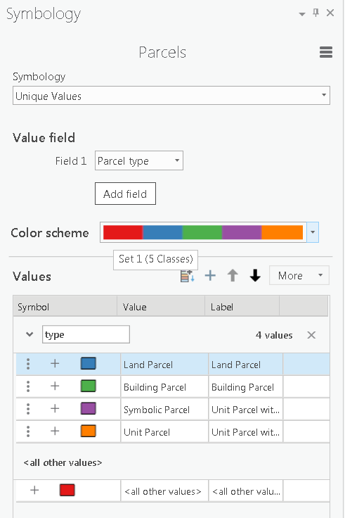
FeatureLayer Renderer
For more complicated renderers use the ‘Renderer Definition’ classes and CreateRenderer method.
await QueuedTask.Run(() => {
//construct unique value renderer definition
UniqueValueRendererDefinition uvr = new
UniqueValueRendererDefinition() {
ValueFields = new string[] {"Parcel type"},
ColorRamp = colorRamp.ColorRamp
};
//set the renderer to the feature layer
layer.SetRenderer(layer.CreateRenderer(uvr));
});

Slide 15
Layer Factory
Layers can be created with Renderers all in one shot with the LayerFactory
var map = MapView.Active.Map;
return QueuedTask.Run(() => {
LayerFactory.CreateFeatureLayer(
new Uri(@"c:\data\countydata.gdb\counties"), map,
layerName: "Population Density (sq mi) Year 2010",
rendererDefinition: new GraduatedColorsRendererDefinition("POP10_SQMI"));
});
Notes:
Overloads that accept Item, Uri, and Data Connections (eg to SDE Enterprise databases)

Slide 16
RasterLayer has Colorizer
Equivalent of the FeatureLayer Renderer
Use LayerFactory to create a Raster Layer
GetColorizer() and SetColorizer()
var map = MapView.Active.Map;
string url =
@"http://imagery.arcgisonline.com/arcgis/services/LandsatGLS/GLS2010_Enhanced/ImageServer";
ImageServiceLayer imgSvcLayer = (ImageServiceLayer)LayerFactory.CreateLayer(new Uri(url), map);
// Get the colorizer from the image service layer
CIMRasterColorizer rasterColorizer = imgSvcLayer.GetColorizer();//Like GetRenderer
// Update the colorizer properties
rasterColorizer.Brightness = 10;
rasterColorizer.Contrast = -5;
rasterColorizer.ResamplingType = RasterResamplingType.NearestNeighbor;
// Update the image service layer with the changed colorizer
imgSvcLayer.SetColorizer(rasterColorizer);//Like SetRenderer
Notes:
Covering selection in more detail in the next lecture.
Can choose styles and specific symbols in renderer.
Heat map renderer now available.
Run FeatureLayer demo

Slide 17
Selection
BasicFeatureLayer, StandaloneTable
public Selection GetSelection()
public Selection Select(QueryFilter queryFilter, SelectionCombinationMethod method)
Map
public Dictionary<MapMember, List<long>> GetSelection()
public Dictionary<MapMember, List<long>> SetSelection(
IReadOnlyDictionary<MapMember,List<long>> mapMemberIds,
SelectionCombinationMethod method
Notes:
We introduce Selection here just for completeness. We cover selections, row cursors, etc.,etc. in much more detail tomorrow.
RowCursor is equivalent to Geodatabase Icursor, IFeatureCursor.
Selection is equivalent to ISelectionSet

Slide 18




